Slide 1

Model Inference
By

Slide 2
Inference Acceleration
Accelerating LLM Inference with
KV cache and Paged KV cache
continuous Batching
Speculative Decoding
Quantization
Technique | Purpose
KV Cache | Avoid recomputing attention
Continuous Batching | Improve GPU utilization
Speculative Decoding | Reduce large-model forward passes
Quantization | Reduce memory and computation
Paged KV Cache | Efficient KV cache memory management

Slide 3
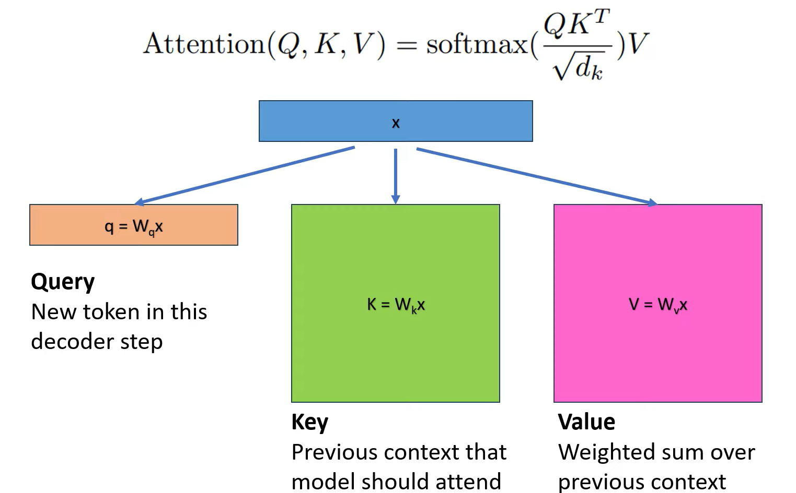
KV-Cache

Slide 4
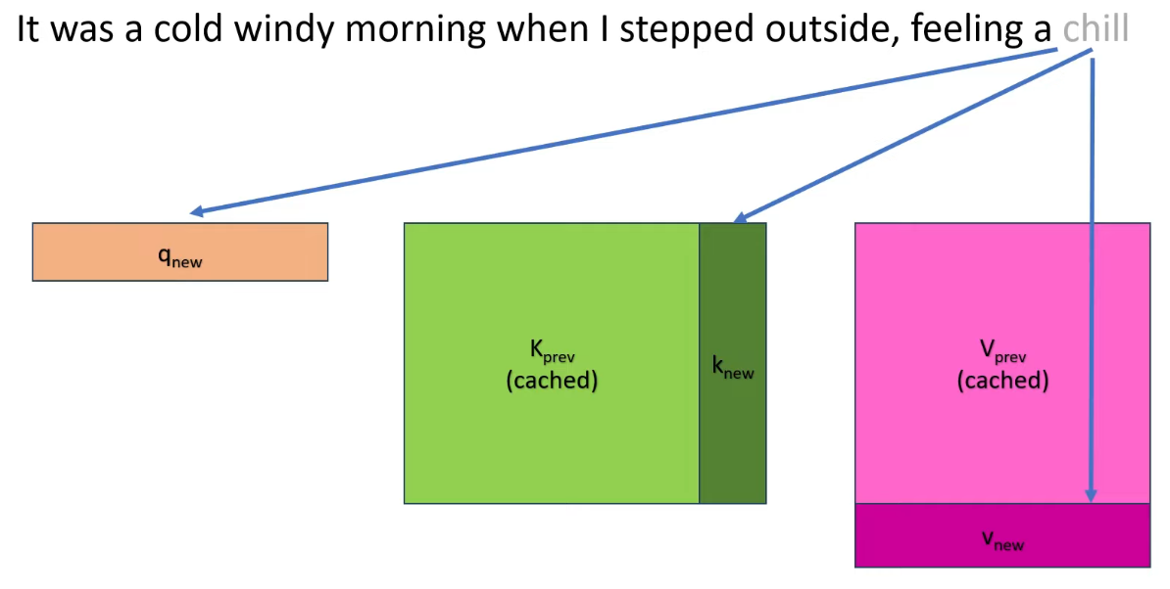
KV-Cache
Accelerating LLM Inference with KV cache

Slide 5
KV-Cache
KV cache Memory usage
KV cache memory = 2 × precision × n_layers ​× d_model​ × seq_len ​× batch
2 (K and V matrices)
precision = 2 bytes (FP16)
layers = 16
d_model = 2048 (embedding size of a token)
sequence length = 1024 (input sentence length)
batch = 128
KV cache for 3B model
2*2*16*2048*1024*128 = 17,179,869,184 bytes /(1024^3) = 16GB
LLM inference is usually memory-bound rather than compute-bound. Multiple GPUs are used primarily to distribute model weights and KV cache and to increase memory bandwidth, not just for compute.

Slide 6
Paged KV cache
Paged KV Cache (Paged Attention) :
Paged KV cache stores the KV cache in fixed-size memory blocks (pages) instead of allocating a large continuous memory region.
Benefits:
Reduces GPU memory fragmentation
Allows dynamic request batching
Enables efficient continuous batching
Notes:
Batching improves efficiency when multiple requests arrive concurrently, allowing the GPU to process them together in a single forward pass.

Slide 7
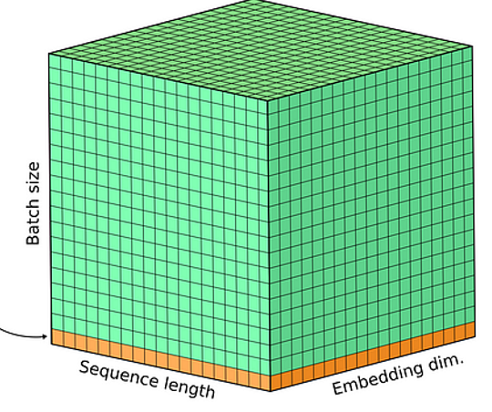
Batching
Batching improves efficiency when multiple requests arrive concurrently, allowing the GPU to process them together in a single forward pass.
Without batching:
Request 1 → GPU run Request 2 → GPU run Request 3 → GPU run
Each request runs separately.
With batching:
Batch = [Request1, Request2, Request3] GPU processes all together
This improves:
GPU utilization
Throughput (requests per second)
Notes:
Batching improves efficiency when multiple requests arrive concurrently, allowing the GPU to process them together in a single forward pass.

Slide 8
Continuous batching
Input and output lengths can greatly vary, leading to very different generation times.
Continuous batching allows new requests to be dynamically added to the batch as soon as previous requests finish, without waiting for the entire batch to complete. So the batch is continuously updated during inference.
T1 | T2 | T3 | T4 | T5 | T6 | T7 | T8 |  | T1 | T2 | T3 | T4 | T5 | T6 | T7 | T8
I1 | I1 | I1 | O1 |  |  |  |  |  | I1 | I1 | I1 | O1 | O1 | End
I2 | I2 | O2 |  |  |  |  |  |  | I2 | I2 | O2 | O2 | O2 | O2 | O2 | End
I3 | I3 | I3 | O3 |  |  |  |  |  | I3 | I3 | I3 | O3 | End
I4 | I4 | I4 | I4 | O4 |  |  |  |  | I4 | I4 | I4 | I4 | O4 | O4 | End
T1 | T2 | T3 | T4 | T5 | T6 | T7 | T8 |  | T1 | T2 | T3 | T4 | T5 | T6 | T7 | T8
I1 | I1 | I1 | O1 |  |  |  |  |  | I1 | I1 | I1 | O1 | O1 | End | I6 | I6
I2 | I2 | O2 |  |  |  |  |  |  | I2 | I2 | O2 | O2 | O2 | O2 | O2 | End
I3 | I3 | I3 | O3 |  |  |  |  |  | I3 | I3 | I3 | O3 | End | I5 | I5 | O5
I4 | I4 | I4 | I4 | O4 |  |  |  |  | I4 | I4 | I4 | I4 | O4 | O4 | End | I7
Traditional Batching
I = Input token
O= Generated Token
Continuous Batching

Slide 9
Speculative Decoding
Using a small fast model to speculate future tokens and let the large model verify them in one pass.
How speculative decoding works
Two models are used:
Draft model (small & fast)
Target model (large & accurate)
Step 1 – Draft model predicts multiple tokens
Step 2 – Large model verifies them
Speculative decoding is implemented in systems like:
TensorRT-LLM
vLLM
Hugging Face Transformers

Slide 10
Core Layers of Model Inference
Model inference is the process of using a trained machine learning model to make predictions on new data.
During inference the system must be:
fast
scalable
memory efficient
able to serve many users
That is why production inference requires multiple infrastructure layers, not just the training framework.
Core Layers of Model Inference
Model Optimization Layer ↓ Inference Runtime / Engine ↓ Inference Server
Each layer solves a different problem.

Slide 11
Layer 1 — Model Optimization
Model optimization transforms a trained model into a faster and more efficient version before execution.
These tools transform models into optimized graphs or kernels.
It reduces:
latency
GPU memory usage
compute cost
Common techniques:
Graph fusion
Layer fusion
Kernel fusion
Quantization (FP16 / INT8 / 4bit)
Memory planning
Tensor parallelism planning
PyTorch model
↓
ONNX export
↓
TensorRT optimization (.plan)
↓
TensorRT engine
↓ GPU execution

Slide 12
Layer 1 — Model Optimization
Framework | Ecosystem | Standout Feature (2026)
TensorRT-LLM or TensorRT | NVIDIA | PagedAttention integration & native FP4 support for LLMs.
FasterTransformer | NVIDIA | Now largely superseded by TensorRT-LLM but used for custom C++ backends.
OpenVINO | Intel | Speculative Decoding on NPUs; optimized for "Agentic AI" pipelines.
Olive | Microsoft | Automated "Passes" that search for the best quantization (INT4/FP8).
ONNX Runtime | Microsoft | The "universal glue"; supports 15+ Execution Providers (EPs).
Apache TVM | Open Source | Unity architecture—unified optimization across Relax and TIR layers.
AITemplate / Torchscipt | Pytorch (Meta) | Transforms models into pure C++ code with zero framework overhead.

Slide 13
Layer 2 — Inference Runtime / Engine
An inference runtime executes the optimized model on hardware.
It manages:
GPU kernels
memory allocation
KV cache
token generation
batching
The runtime is essentially the execution engine for the neural network.
These run general deep learning models.
Runtime | Provider
ONNX Runtime | Microsoft
TensorRT Runtime | NVIDIA
OpenVINO Runtime | Intel
TorchScript Runtime | Meta Platforms

Slide 14
Layer 2 — Inference Runtime / Engine
LLM Specialized Runtimes
Runtime | Provider | Key Feature
vLLM | University of California, Berkeley | PagedAttention
DeepSpeed | Microsoft | ZeRO inference
SGLang | Stanford University | Structured generation
LMDeploy | OpenMMLab | LLM acceleration
llama.cpp | ggerganov | CPU inference
ExLlama | turboderp | Quantized GPU runtime
TensorRT-LLM | NVIDIA | GPU runtime

Slide 15
Layer 3 — Inference Server
What is an Inference Server?
An inference server exposes the model as an API that applications can call.
It handles:
HTTP / gRPC endpoints
Request batching
request scheduling / Routing
scaling
multi-model deployment
Without an inference server you would need to build these systems manually.

Slide 16
Layer 3 — Inference Server
Server | Provider
NVIDIA Triton Inference Server | NVIDIA
TorchServe | Meta Platforms
TensorFlow Serving | Google
Ray Serve | Anyscale
KServe | Kubernetes community
Text Generation Inference | Hugging Face
vLLM API Server | University of California, Berkeley
Notes:
https://docs.vllm.ai/projects/recipes/en/latest/Microsoft/Phi-4.html

Slide 17
Layer 3 — Inference Server
NVIDIA Production Stack
vLLM Stack
Hugging Face Stack
Training
PyTorch
↓
Model Export
ONNX
↓
Optimization
TensorRT
↓
Runtime
TensorRT Runtime
↓
Server
Triton Inference Server
↓
Application
HTTP / gRPC
Model
PyTorch Transformer
↓
Runtime
vLLM
↓
Batching + KV Cache
PagedAttention
↓
API
vLLM API Server
↓
Client Applications
Chatbots / APIs
Transformers
↓
Accelerate
↓
Text Generation Inference(TGI) server
↓
HTTP API
Notes:
https://docs.vllm.ai/projects/recipes/en/latest/Microsoft/Phi-4.html

Slide 18
vLLM
https://docs.vllm.ai/en/latest/
https://docs.vllm.ai/projects/recipes/en/latest/index.html
In your terminal, you can https://docs.vllm.ai/en/latest/getting_started/installation/ vLLM,
then start the server with the vllm serve (https://docs.vllm.ai/en/latest/configuration/serve_args/) command.
(You can also use our Docker image.)
The vllm serve command is used to launch the OpenAI-compatible server. (https://docs.vllm.ai/en/latest/serving/openai_compatible_server/ )
Notes:
https://docs.vllm.ai/projects/recipes/en/latest/Microsoft/Phi-4.html

Slide 19
Thank you

